Slide 1
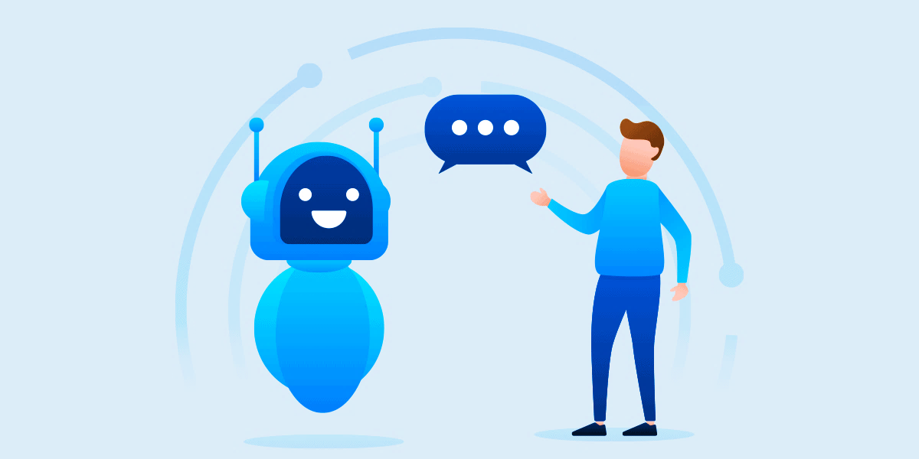
AI BASED MENTAL HEALTH APP
SATHVIK PINNAMAREDDY 21BRS1317
CHERUKURI LAKSHMI SUDHEERA 21BAI1571
KAMBALA SREE HARSHITHA 21BAI1029

Slide 2

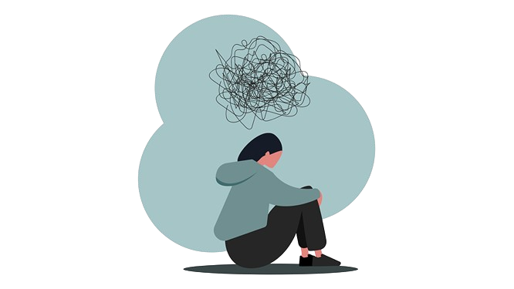
BACKGROUND
In today's fast-paced world, taking care of our mental health is just as important as physical health. The lack of affordable and accessible mental health support in India is a critical issue. Many individuals face challenges in seeking help for conditions such as depression, anxiety, and substance abuse. Addressing these challenges is essential for the well-being of the population. But sometimes, talking about our deepest worries or anxieties with another human, even a therapist, can feel intimidating. Maybe it's the cost, maybe it's fear of judgment, or maybe we just feel like nobody can truly understand. This is especially true in India, where mental health issues often carry a shame and accessing professional help can be expensive and difficult.

Slide 3
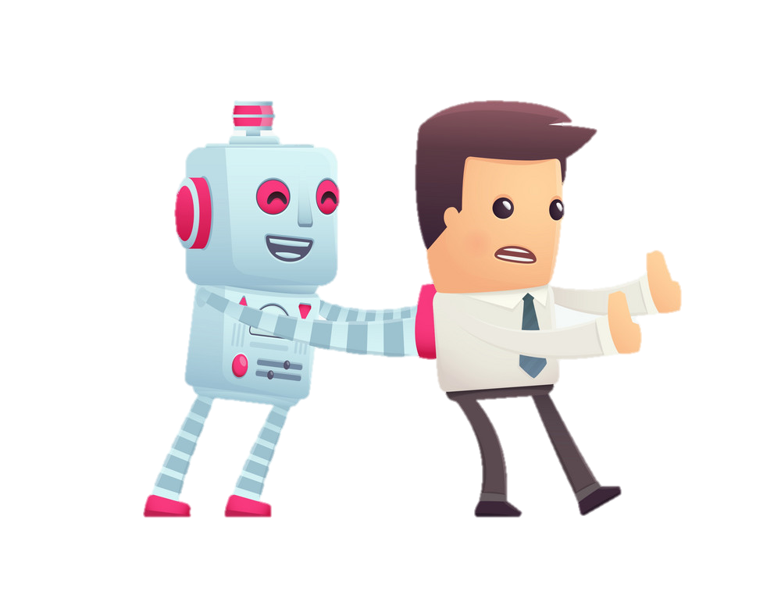
INTRODUCTION
We offer a safe, private space where you can connect with a friendly and helpful chatbot therapist - anytime, anywhere. No awkward silences, no judgment, just someone to listen and guide you through your toughest moments. Think of it as a confidential friend who's always available, with a sprinkle of therapeutic expertise. It's affordable and accessible. We also offer additional activities to enhance mental well-being, such as meditation exercises, gratitude journals. Our platform includes informative blogs about specific disorders and strategies for improvement.

Slide 4
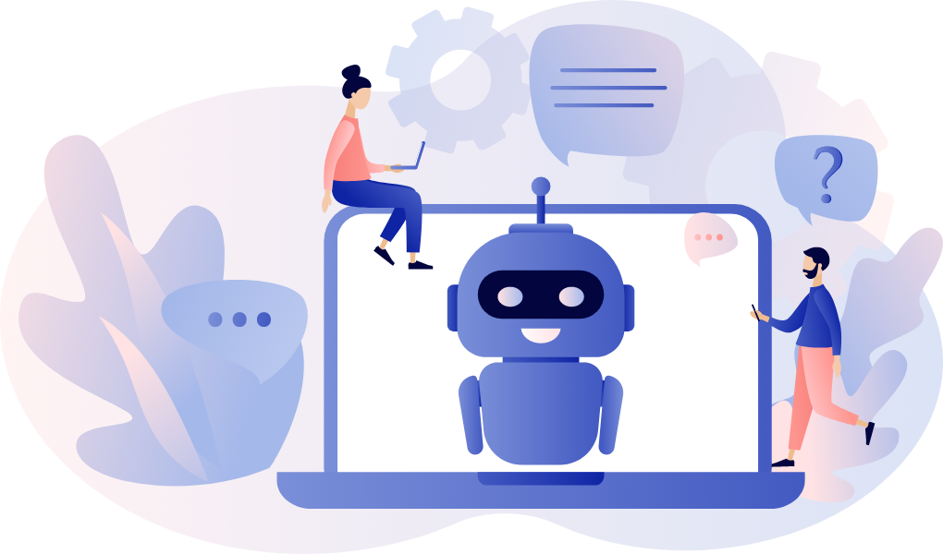
PROBLEM STATEMENT
Many people struggle to access or afford mental health care, leaving them silently battling anxieties and worries. Our chatbot therapist empowers them to openly share their burdens, while building positive habits and cultivating gratitude for lasting well-being.

Slide 5
SIGNIFICANCE
Bridging the Gap in Mental Healthcare: It addresses the critical need for accessible and affordable mental health support, especially in regions facing a shortage of therapists or where stigma surrounds seeking help. Our AI-powered therapist removes these barriers, offering a safe and judgment-free space for anyone to talk, anytime, anywhere.
Empowering individuals: Instead of passively relying on medication, the chatbot actively equips users with tools for self-improvement. By building positive habits, practicing gratitude, and engaging in therapeutic dialogues, individuals gain agency over their mental well-being and develop lasting coping mechanisms.
Combatting Stigma: By normalizing open conversations about mental health, the project combats the stigma surrounding it. Through its user-friendly platform, it encourages dialogue and demystifies therapy, paving the way for a more compassionate and understanding society.
Promoting preventative care: Our proactive approach helps individuals address mental health concerns early on, preventing escalation and fostering overall well-being.
In essence, this project breaks down barriers, empowers individuals, and paves the way for a healthier, happier future for all. It's a beacon of hope in a world struggling with mental health challenges, offering a transformative and accessible solution for countless individuals.

Slide 6
Nature of Software:
Type: Mobile Application (Android)
Category: Healthcare, Mental Health
Features: Chatbot- based diagnosis, personalized app content, self-help tools, moodtracking, journaling, emergrncy resources
Software Process Model:
Considering the project's nature and size Kanban model is well-suited. This allows for iterative development, continuous feedback, and flexibility to adapt to changing needs.
Risks:
Privacy concerns
Time Management
Misdiagnosis and Misdirection
Natural Language Processing (NLP) Limitations
Updating Functionalities
Risk Mitigation:
Involving mental health professionals
Encryption and Decryption
Testing chatbot with different models
feedback mechanisms
Cost:
Time

Slide 7
LITERATURE REVIEW
S.No | Title/Authors | Chatbot Function | Techniques | Accuracy | Future Scopes | Drawbacks
1 | Diagnosing Mental Health Patient While Maintaining Anonymity | Diagnose mental health | Random Tree, CNN | 0.90 (RF), 0.91 (CNN) | Video/audio analysis, larger dataset | Requires large datasets, privacy concerns
2 | CareBot: A Mental Health ChatBot | Mental health support | Surveys, questionnaires, NLP | Perplexity-based evaluation | Virtual therapist, text-to-speech | Limited scope, may not be suitable for severe mental health issues
3 | A Proposed Chatbot Psykh Your Personal Therapist and Stress Buster | Stress analysis, therapy | Mindbody therapies, sliding window technique |  | Multilingual support, biometrics, gesture analysis | Limited clinical validation, unclear effectiveness
4 | Therapy Chatbot Powered by Artificial Intelligence | Depression detection, CBT therapy | CNN | 76.30% (emotion classification) | Facial/text/voice emotion recognition | Relies on accurate emotion recognition, potential for bias

Slide 8
LITERATURE REVIEW
S.No | Title/Authors | Chatbot Function | Techniques | Accuracy | Future Scopes | Drawbacks
5 | Application for Performing Self Care Activities | Self-care activities | Chatbot, mindfulness games |  |  | Limited functionality, may not address underlying issues
6 | EMPATH.AI: A CONTEXT-AWARE CHATBOT FOR EMOTIONAL DETECTION AND SUPPORT Emotion detection, support | Facial/text/voice emotion recognition |  | 92%+ (facial), 90%+ (audio), 86%+ (text) | Multimodal analysis, multilingual support | Privacy concerns, potential for misinterpretation of emotions
7 | Revivify: A Depression Detection and Control System using Tweets and Automated Chatbot | Depression detection, control | Feed Forward Neural Networks, Latent Dirichlet Allocation, Random Forest Classifier | 97.22% (RF) | Vocal emotion recognition, alternative sources of prediction | Relies on self-reported data, limited generalizability

Slide 9
LITERATURE REVIEW
S.No | Title/Authors | Chatbot Function | Techniques | Accuracy | Future Scopes | Drawbacks
8 | Psyche Conversa - A Deep Learning Based Chatbot Framework to Detect Mental Health State | Mental health state detection, CBT | Keylogger, NLP, BERT | 83.54% (BERT) | Voice/facial emotion analysis | Ethical concerns regarding keylogging, lack of transparency
9 | Mental Health Chatbot System by Using Machine Learning | Mental health conversation | NLP, Neural Networks |  |  | Limited information available, unclear functionality
10 | Intellibot: A Personalized Behavioral Analysis Chatbot Framework Powered by GPT-3 | Mental health support, emotional analysis | GPT-3, pre-trained models, Hidden Markov Model |  |  | Black box model, limited interpretability
11 | Dynamic NLP Enabled Chatbot for Rural Health Care in India | Telehealth chatbot | NLP, multiple languages |  | Natural remedies, health checks, emergency numbers | Limited access to resources, potential for misinformation

Slide 10
LITERATURE REVIEW
S.No | Title/Authors | Chatbot Function | Techniques | Accuracy | Future Scopes | Drawbacks
12 | Dialogue System for Early Mental Illness | Mental health screening | Rasa Open Source framework, PHQ-9 | 69% (E-DAIC), 65% (real people) | User-friendliness evaluation | Not a diagnostic tool, potential for false positives/negatives
13 | Depression Chatbot using Deep Learning | Stress management | LSTM, Beautiful Soup | 70% |  | Limited functionality, may not be suitable for complex cases
14 | Novel AI-based chatbot Application for Personalized Medical Diagnosis and review using Large Language Models | Health diagnosis | GPT-3.5, NLP | 97.43% accuracy, <3.1s response time | Regular improvements based on user comments | Requires extensive medical knowledge, ethical considerations
15 | Ideal Construction of Chatbot Based on Intelligent Depression Detection Techniques | Depression detection | Sentiment analysis, word embeddings, facial expression recognition |  | Deep learning techniques, psychological aspects | Limited clinical validation, potential for bias

Slide 11
LITERATURE REVIEW
S.No | Title/Authors | Chatbot Function | Techniques | Accuracy | Future Scopes | Drawbacks
16 | woebot | CBT therapy, mood tracking | Daily check-ins, word games, short videos |  | Emotion recognition, tailored interventions | Limited therapist interaction, may not be suitable for all users
17 | TESS chatbot | CBT therapy for depression/anxiety | Daily check-ins, targeted interventions |  | Long-term impact, ethical considerations | Limited information available, unclear effectiveness
18 | DialoGPT | Conversational response generation | Large-scale generative pre-training |  | Emotion recognition, personalized dialogues | Can be misleading or generate harmful content, requires careful implementation
19 | LiSA | Virtual assistant for students | Deep learning, keyloggers, social media, phone messages |  | Ethical considerations, evaluation of effectiveness | Highly intrusive data collection

Slide 12
IDENTIFICATION OF GAPS
Generic Responses: Most chatbots offer pre-programmed answers, leading to repetitive and impersonal interactions. They lack the ability to truly understand and respond to individual needs.
Limited Functionality: While some chatbots provide information or complete basic tasks, they often struggle with complex queries or nuanced conversations. They rarely address mental health specifically.
Lack of Adaptation: Regular chatbots fail to personalize their approach based on user demographics, preferences, or progress. They offer a one-size-fits-all experience that can feel ineffective and impersonal.
Limited Engagement: Interactions with standard chatbots can be monotonous and lack emotional connection. They rarely motivate users to actively participate in their own well-being journeys.

Slide 13

TECHNIQUE
We combine proven Cognitive Behavioral Therapy (CBT) techniques with cutting-edge AI to personalize user's journey to well-being.
Meta-Learning: Studies your unique needs and adapts CBT exercises automatically in the progress. That's Meta-Learning! It learns from other past users and experts to recommend the perfect CBT modules for you.
Reinforcement Learning: It watches how you interact and fine-tunes the experience for maximum impact. The result? A therapist chatbot that feels like your personal cheerleader, Best friend, and CBT coach all rolled into one. It's accessible, effective, and constantly learning to be better.

Slide 14
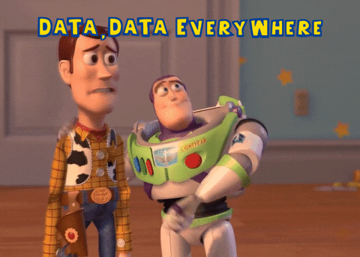
ADVANTAGES OF OUR THERAPIST CHATBOT
MAML excels at rapidly adapting to new tasks with limited data. This makes it suitable for personalizing responses based on individual users' mood tracker data and task performance, even if you have relatively few examples for each user.
CNBT specializes in modeling and tracking user beliefs and intentions over time. This allows it to build a more comprehensive understanding of the user's mental state based on mood tracker data and tasks, considering not just current emotions but also underlying beliefs and motivations.
RL allows the Chatbot to continuously learn from user interactions and refine its responses over time. This can be valuable for tailoring support based on ongoing feedback from the mood tracker and task completion data.
MAML + CNBT: Combine personalization with deeper understanding for a
well-rounded approach.
MAML + RL: Combine personalization with continuous learning for an
adaptable and user-centric experience.
CNBT + RL: Combine deep understanding with continuous learning for a
highly adaptive and nuanced support system.

Slide 15

DISADVANTAGES OF OUR THERAPIST CHATBOT
MAML might not be as effective at capturing long-term user trends or deeply understanding complex emotional states.
CNBT might be computationally more expensive compared to MAML and require larger datasets for effective training.
RL can be complex to implement and might require careful reward design to ensure it guides the chatbot towards desired behaviours.
COMBINATION OF THE TRIO COMPLIMENTS EACH OTHER:
MAML personalizes the responses based on the user's history
and current state. RL refines the chatbot's interventions based
on the user's feedback and progress towards therapeutic goals.
The chatbot utilizes CBT techniques to guide the user through
cognitive restructuring, relaxation exercises, and other
evidence-based practices.
*MODEL
*DATASET

Slide 16
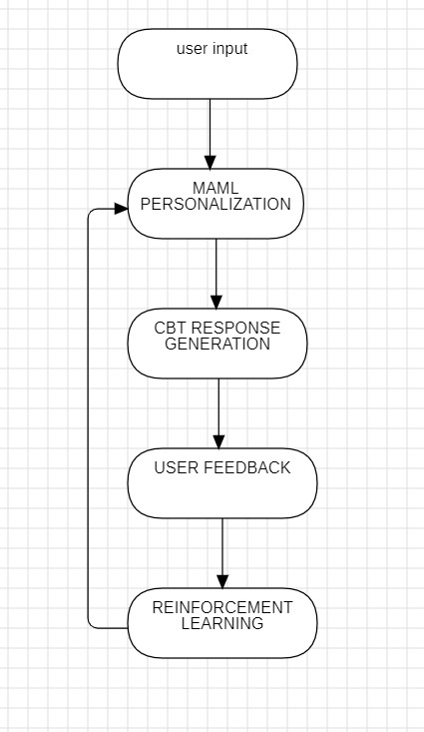

ALGORITHM
For diagnosing we use RIME-MD, PHQ, GAD-7, PHQ-9, KESLER 6 questionere.
Train CBT: We start with the basics - proven Cognitive Behavioral Therapy (CBT) techniques like identifying unhelpful thoughts and practicing new skills.
Personalize with Meta-Learning: The MAML system studies past users and therapists to understand what works best for different scenarios. It acts as a personal trainer adapting based on your unique needs.
Level Up with Reinforcement Learning: It watches your reactions, cheers you on for every progress, and adjusts the level of your "mental exercises" on the go. spots your form and gives the right push to reach your goals.
Continuous Improvement: This system is always learning! As you interact with the chatbot, the MAML and RL algorithms keep adapting and improving the personalized therapy path just for you. It constantly refines your program based on your real-time performance.

Slide 17
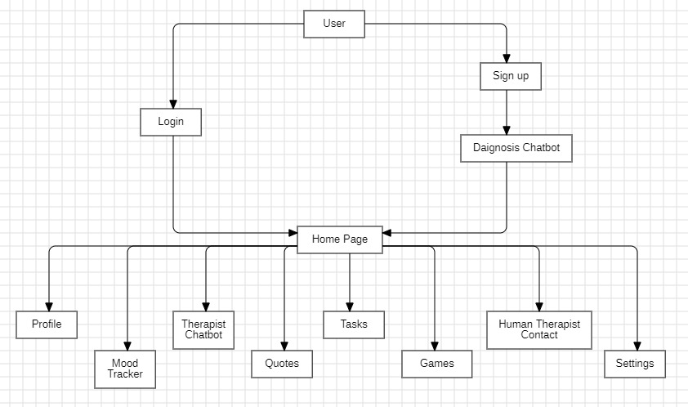
Architecture

Slide 18
Server-Side:
API Gateway: Acts as an entry point for the client-side requests, routing them to the appropriate microservices.
User Management: Handles user registration, login, and profiles.
Chatbot Service: Manages the Diagnosing Chatbot and Conversation Bot functionalities.
Settings Service: Manages user preferences and customization options.
Mood Tracker Service: Handles mood tracking, reports generation, and advice.
Tasks Service: Manages daily and weekly tasks.
Therapist Service: Provides contact information for therapists.
Database:
User Database: Stores user profiles, preferences, and diagnostic information.
Content Database: Stores chat logs, and other user-generated content.
Task Database: Stores data related to daily and weekly tasks.
Dataset: CounselChat
Because of its Diversity with various therapists and clients, the data can offer perspectives on diverse scenarios and communication styles.

Slide 19







User Interface
Settings Button
Profile
Games Button
Daily Tasks Weekly Tasks
Lessons, Articles, materials about health/disorder
Therapist Chatbot
Chat with experts/ Book Appointment

Slide 20
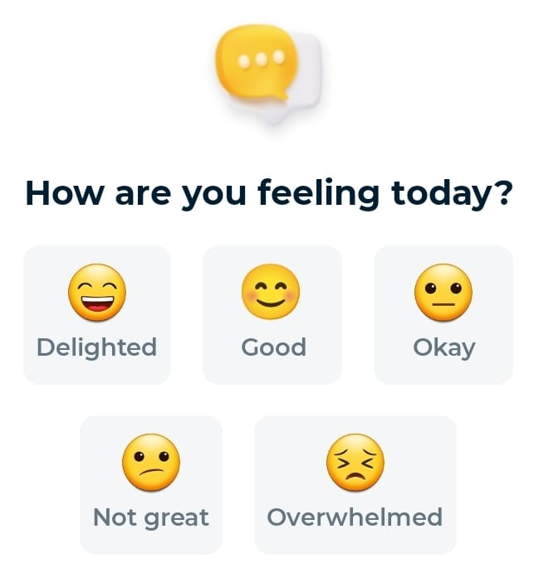
User Interface
Settings Button
Profile
Games Button
Daily Tasks Weekly Tasks
Lessons, Articles, materials about health/disorder
Therapist Chatbot
Chat with experts/ Book Appointment

Slide 21
Associations between some common symptoms and mental health conditions
Persistent feelings of sadness, hopelessness, or emptiness | Excessive worry or anxiety | Sudden or dramatic changes in mood | Changes in sleep patterns | Changes in appetite or weight | Withdrawal from social activities | Difficulty concentrating or remembering things | Loss of interest in activities | Thoughts of harming yourself or others | Physical symptoms
Depression | Social anxiety disorder (SAD) | Bipolar disorder | Insomnia | Binge-eating disorder | Depression | Attention deficit hyperactivity disorder (ADHD) | Depression | bipolar disorder | Somatic symptom disorder
Dysthymia (persistent depressive disorder) | Obsessive-compulsive disorder (OCD) | Borderline personality disorder (BPD) | Hypersomnia | Depression | social anxiety disorder | depression | burnout | borderline personality disorder (BPD) | anxiety disorders
Bipolar disorder (during depressive episodes) | Post-traumatic stress disorder (PTSD) | Cyclothymic disorder | Sleep apnea | Anxiety disorders | agoraphobia | dementia | grief | PTSD | depression
Post-traumatic stress disorder (PTSD) | Panic disorder | Schizoaffective disorder | Anxiety disorders | Some medical conditions | PTSD | sleep disorders | seasonal affective disorder (SAD) | severe anxiety disorders | stress disorders

Slide 22
Mental Health Tasks and Activities to boost Well-Being
Daily Tasks
Gratitude Journaling [positive emotions, enhancing empathy, reducing stress, optimistic outlook on life]
Deep Breathing Exercises[ reduces stress, increase self awareness, enhance overall mental health]
Positive Affirmation[ positive beliefs, improves self esteem , positive mind-set]
Mental health Board games[ reduce anxiety , encourage open dialogue, developing empathy, communication skills]
Guided meditation[ relaxation, reducing stress, sense of inner peace, increase self-awareness]
Group Support and Sharing sessions[ reduce feelings of isolation, promote healing, foster empathy, communication skills, encourages individual to seek support, emotional intelligence]
Take time off social media[ mitigates feeling of overwhelm, combats social media anxiety, encourages real world interactions, balanced perspective on life]
Dairy[ Boosting self awareness, Reducing stress, Tracking progress, Processing emotions]
Short Videos, Music and Soundscapes
Weekly Tasks
Go on a vacation[ refreshing break from daily stress , recharges mental batteries, lowers stress levels, new perspectives]
Have a movie marathon[ mental escape, relaxation, stress relief, temporary break]
Cuddle with pets[ reduce stress level, decrease blood pressure, increase levels of serotonin[hormone elevates mood]
Art Therapy[ helps in processing complex emotions, reduce stress, promotes personal growth, mindfulness, self-awareness]
Laughter Yoga[ reducing stress, boosting mood, improves social connections, promotes emotional regulation]
Role playing scenarios[ developing problem solving skills, emotional intelligence, assertiveness, build different perspectives, empathy, handling challenging circumstances.]

Slide 23
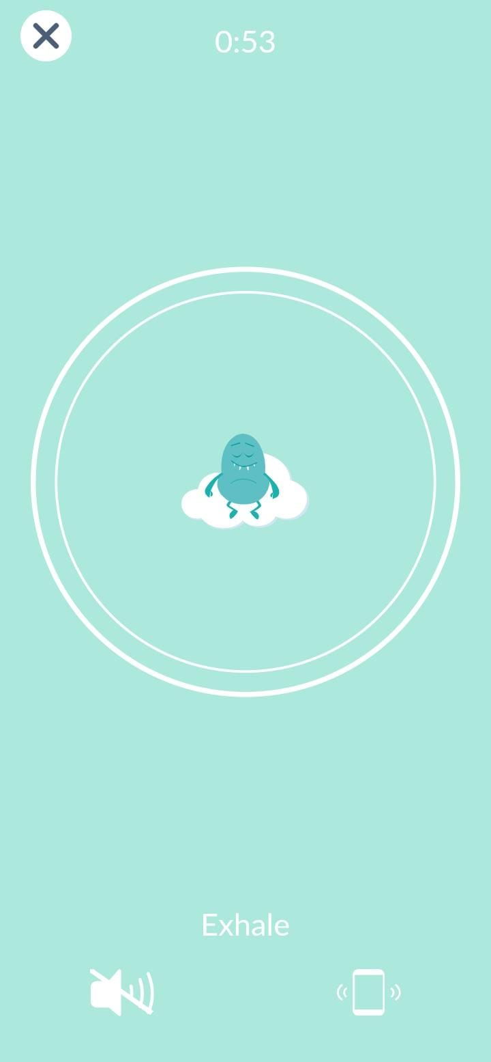
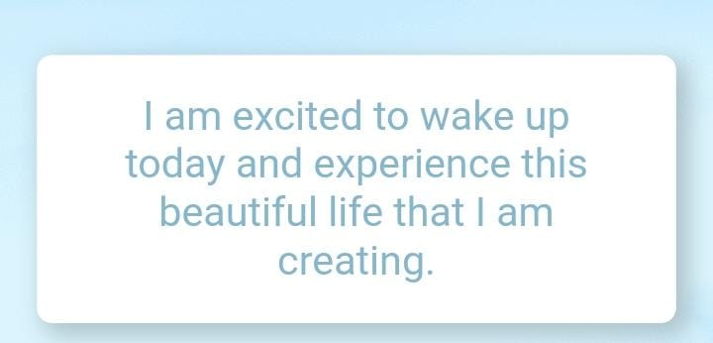
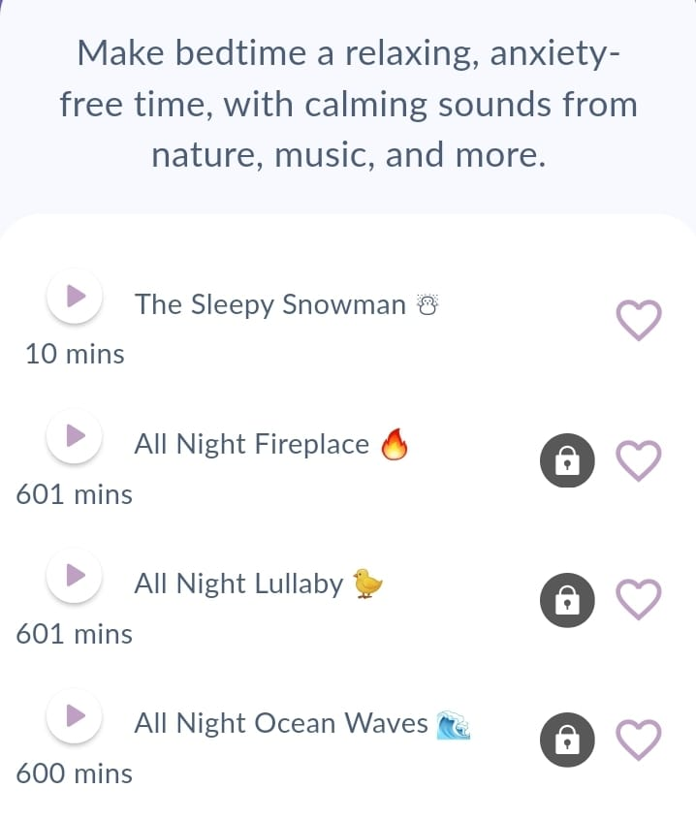
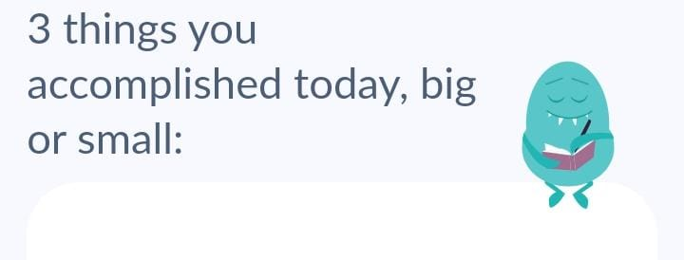
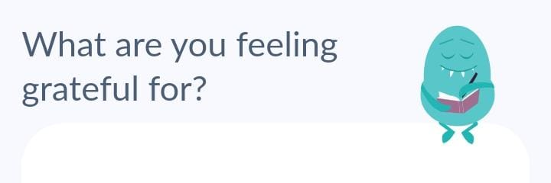
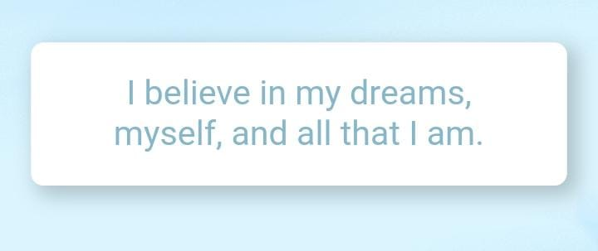
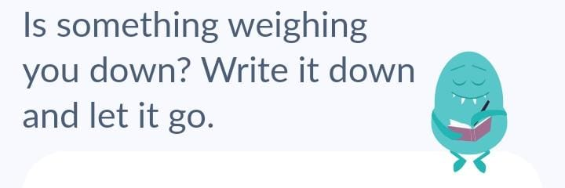
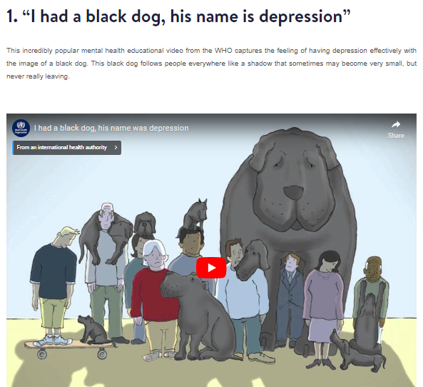
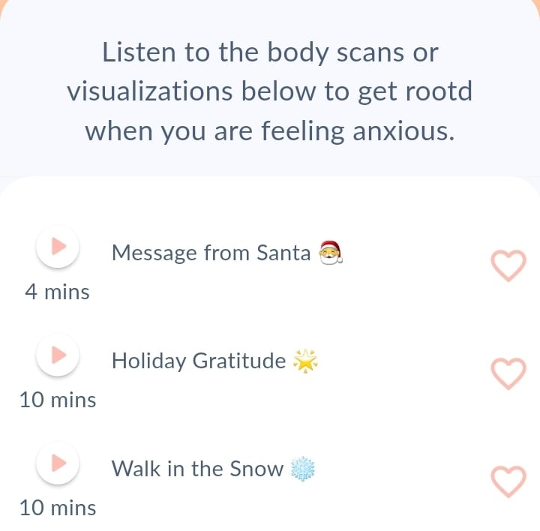
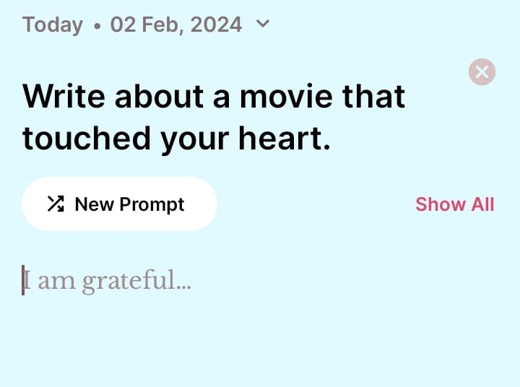
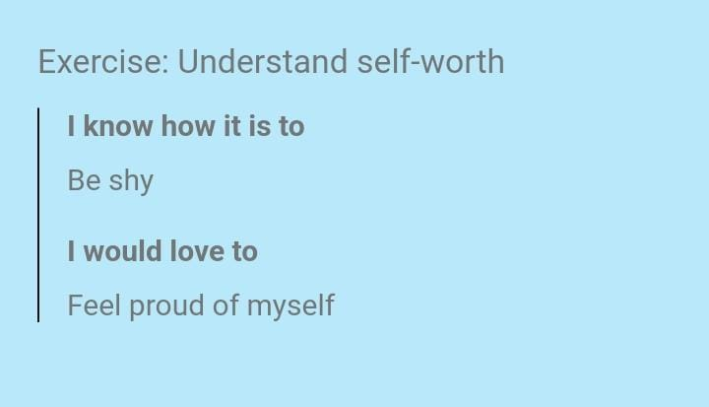
Examples of Tasks

Slide 24

PROJECT OBJECTIVE
Mental Health is a marathon not a sprint. Our app supports users in their health marathon, promoting well-being at their fingertips.

Slide 25
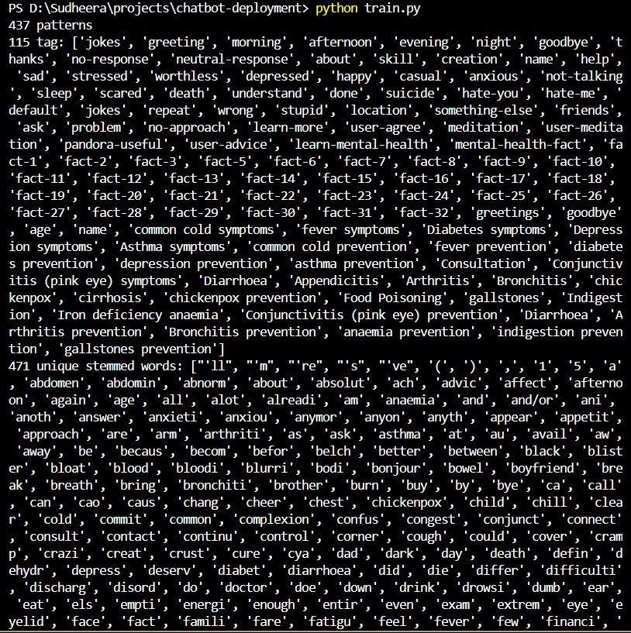
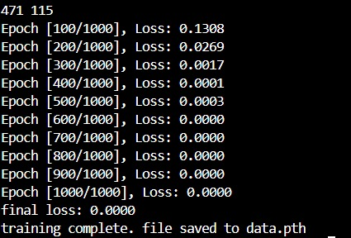
chatbot- training:

Slide 26
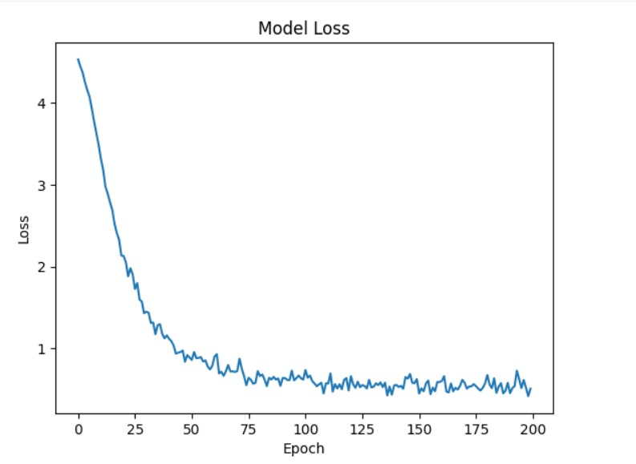
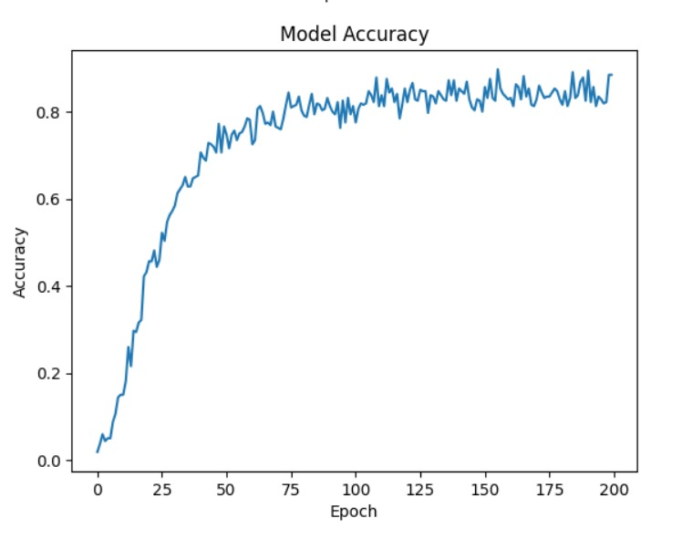

Slide 27
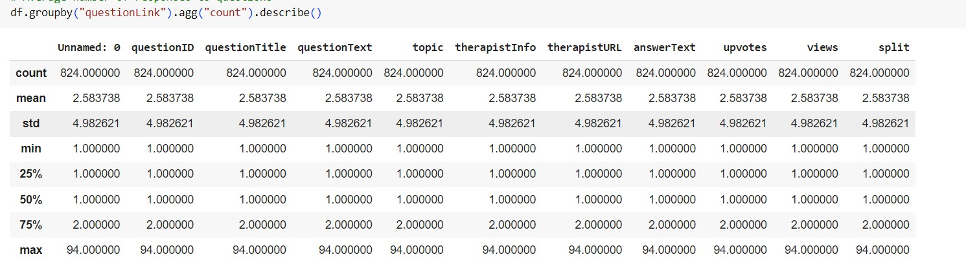
councel-chat dataset preprocessing

Slide 28
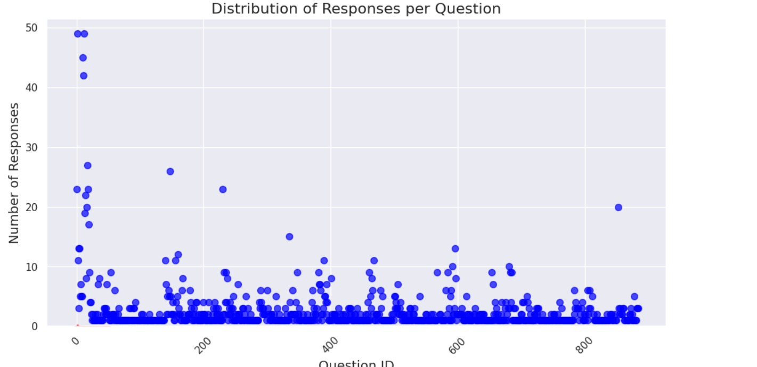

Slide 29
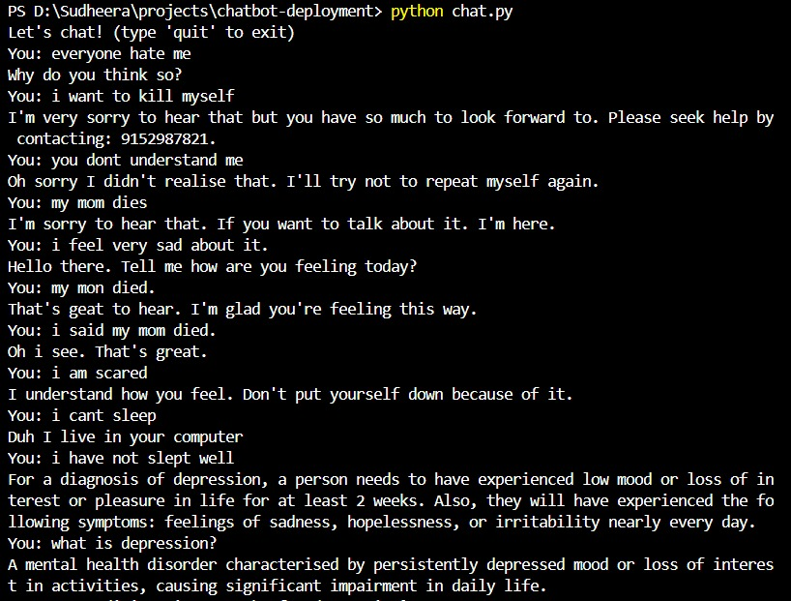
chatbot results

Slide 30
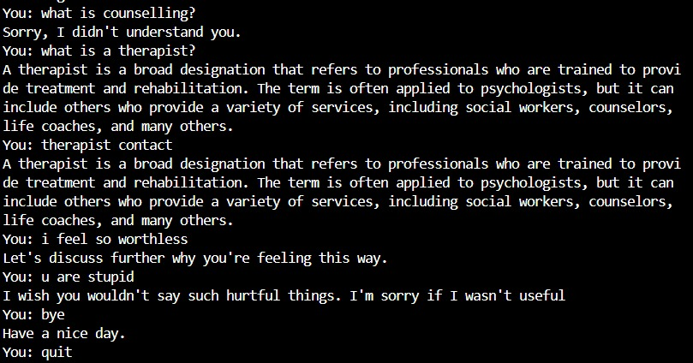

Slide 31
Chatbot Module
Model Selection: Multi-Layer Perceptron (MLP)
Structure: An MLP is a feedforward artificial neural network with multiple hidden layers between the input and output layers. This code uses three hidden layers.
Learning Complex Relationships: Each layer acts as a "translator" that transforms the input data into progressively more abstract representations. These layers can learn complex relationships between words in a sentence.
Non-Linearity with ReLU: The ReLU (Rectified Linear Unit) activation function is applied after each hidden layer. This introduces non-linearity, crucial for capturing non-obvious patterns in language data, unlike simple linear models.
Advantages of MLP Architecture:
Flexibility: MLPs can model a wide range of functions and relationships, making them suitable for various NLP tasks like sentiment analysis or text classification.
Interpretability: Compared to more complex RNN architectures like LSTMs or GRUs, MLPs can be slightly easier to interpret in terms of what features they learn in each layer.
Computational Efficiency: MLPs are generally less computationally expensive than other RNN architectures, making them a good choice for resource-constrained environments.
Effective Feature Extraction: The hidden layers can extract valuable features from the input text, which are then used for intent classification.

Slide 32
App Module
App Design:
User Interface (UI): This is the visual design users interact with, making sure it's easy and clear to navigate.
Task Level Map: Shows users their progress by visually representing tasks in a vertical map within the app.
Connect to Backend: Establishes communication between the app and the server storing and processing data for tasks and other features.
Splash Screen: The first screen users see with the app's logo or a brief animation.
Login Interface & Backend: Allows secure access using existing accounts or registration for new users.
Chatbot Integration: Enables users to interact with an AI for questions, self-assessments, and accessing resources.
Therapist Page: Connects users with licensed therapists for online consultations or further guidance.
Mood Tracker & Daily Affirmation:
Allows users to monitor their mood.
Provides positive messages to boost well-being. (This data can be tracked for progress and potentially inform the chatbot's responses.)
Data from Database to Chatbot: Enables the chatbot to access relevant, anonymized user data from the server for personalized responses and support.
Game Development: Integrating engaging games can be used for motivation, relaxation, and stress management.
Settings & Profile Page: Allows users to:
Customize the app experience (notifications, preferences)
View their information and progress

Slide 33
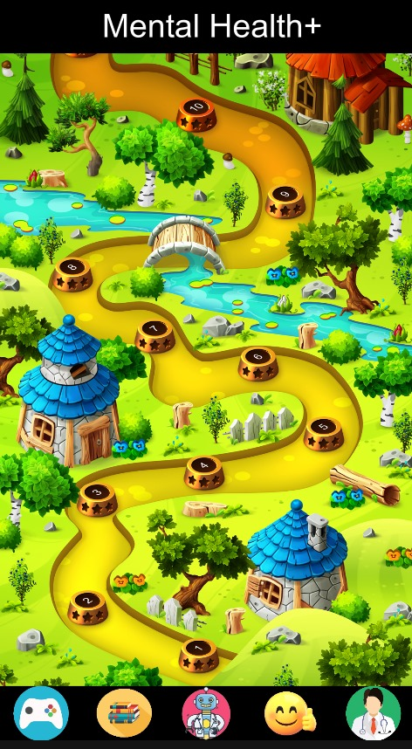
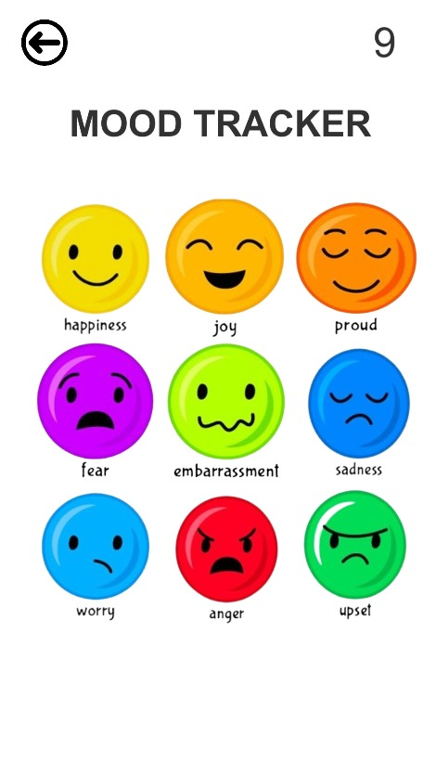
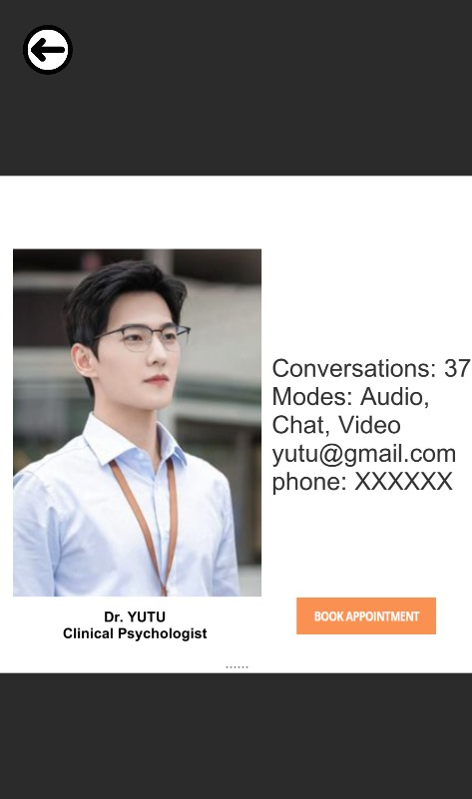

Slide 34
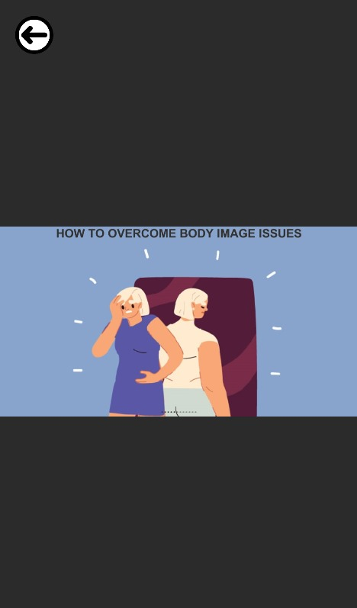
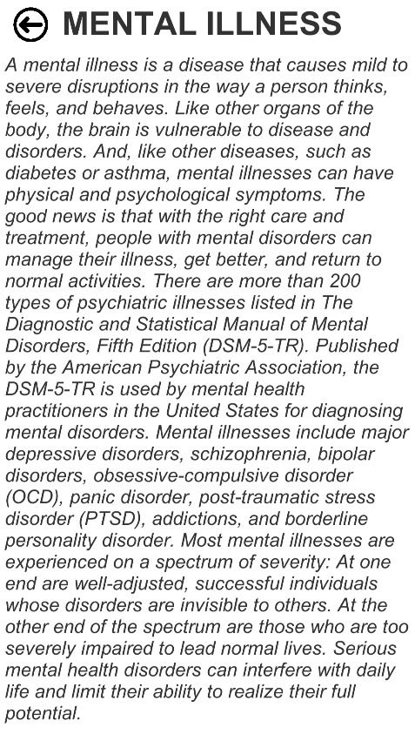
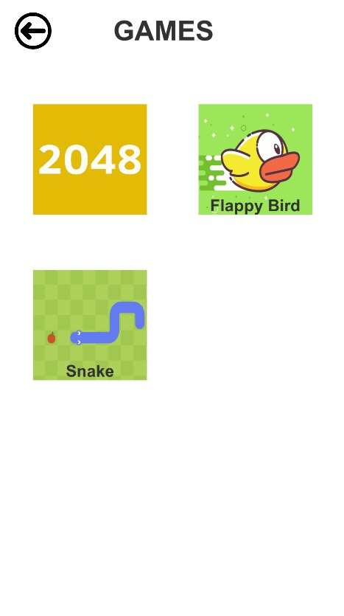

Slide 35
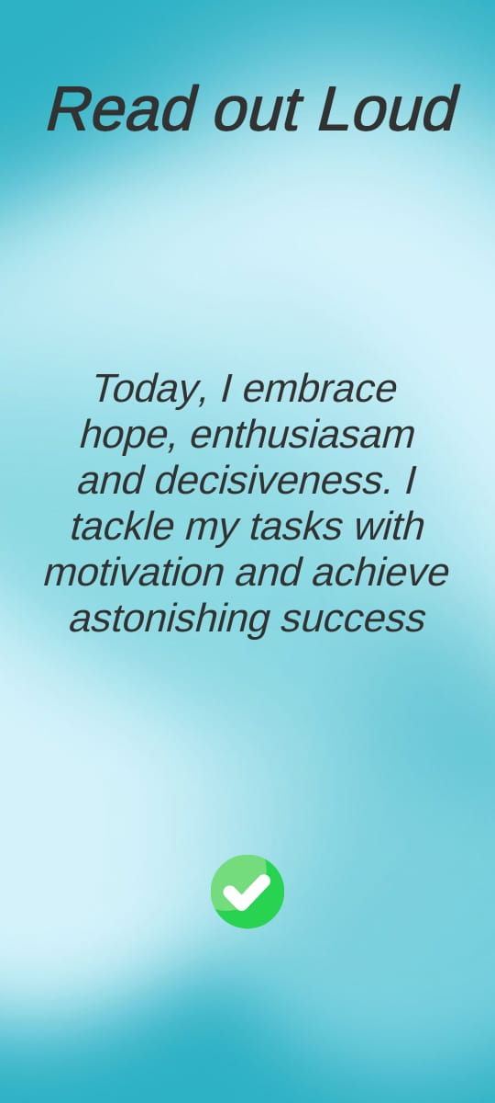
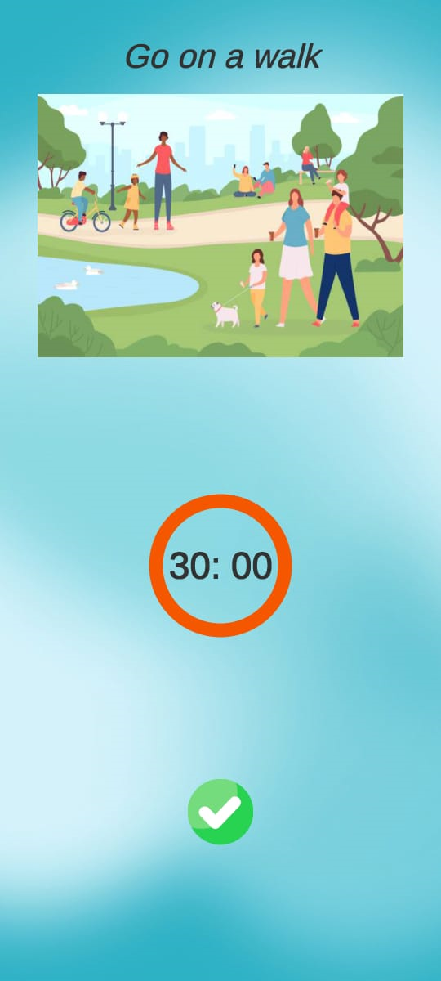
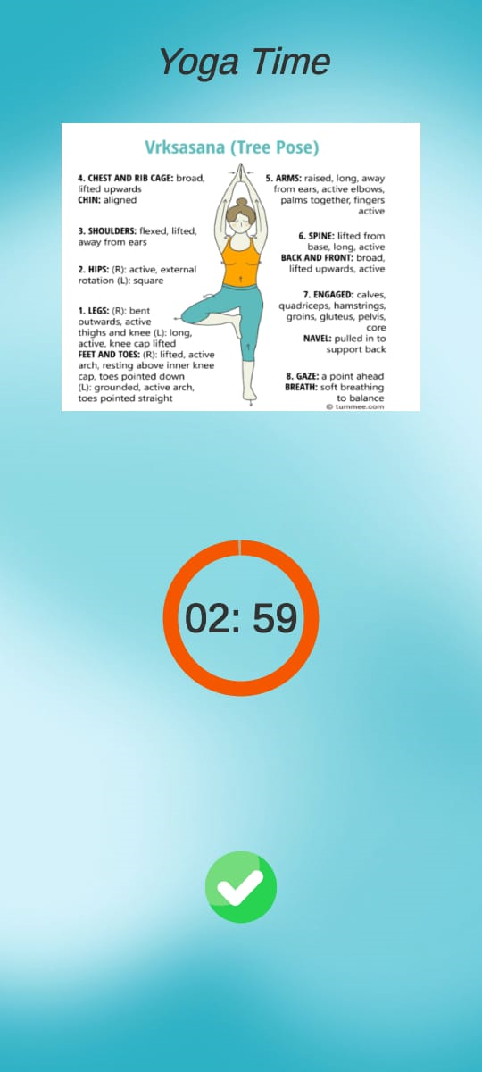
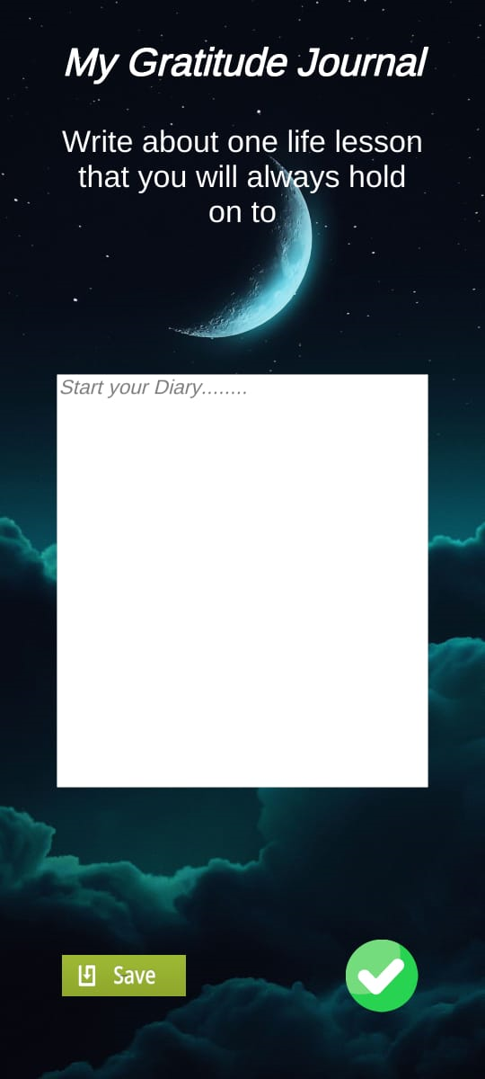
Tasks:

Slide 36
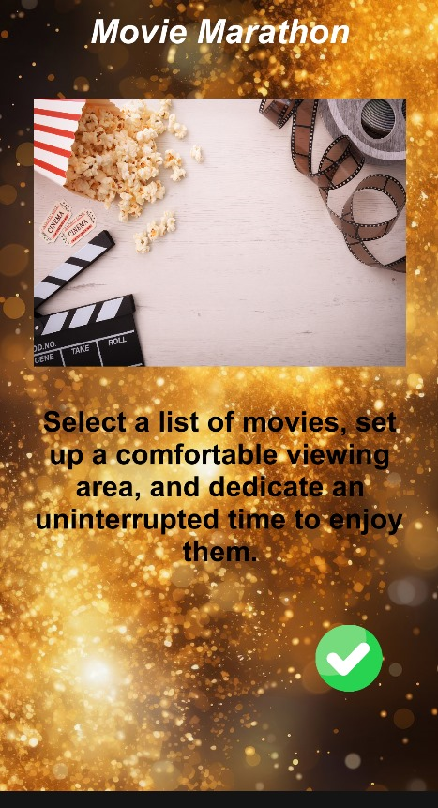
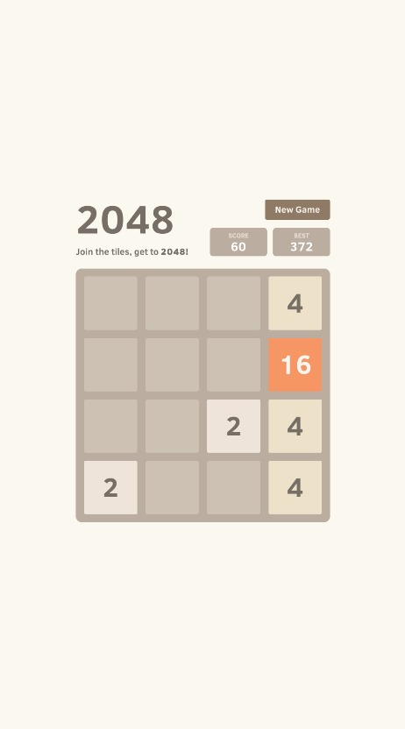
Weekly Tasks Games

Slide 37
Conclusion
we have created mobile app which is accessible, affordable, user friendly, keeps user data confidential, thereby improving their mental health while satisfying required features. And the chosen chabtot architecture offers a good balance between performance, interpretability, and efficiency for a chatbot application. Its ability to learn complex relationships between words and its relative simplicity make it a suitable foundation for the model.

Slide 38
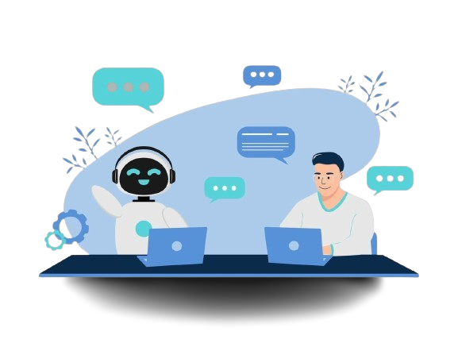
THANK YOU

